Slide 1

Thematic Analysis with Obsidian
Yuri Banens, Griffith Law School
Notes:
⏱ 11:00 · 1 min
Welcome + housekeeping, fast. Flag that this is hands-on — they'll be coding text themselves within ~25 min. Time is tight today, so keep this crisp.

Slide 2

ACKNOWLEDGEMENT OF COUNTRY
Notes:
Brisbane/Meanjin is Yuggera / Turrbal country. I acknowledge that and thank the Yuggera/Turrnbal people here today. Thanks to the Yuggera/Turrbal elders and the upcoming generation.
———
⏱ 11:01 · 1 min
Keep brief.

Slide 3
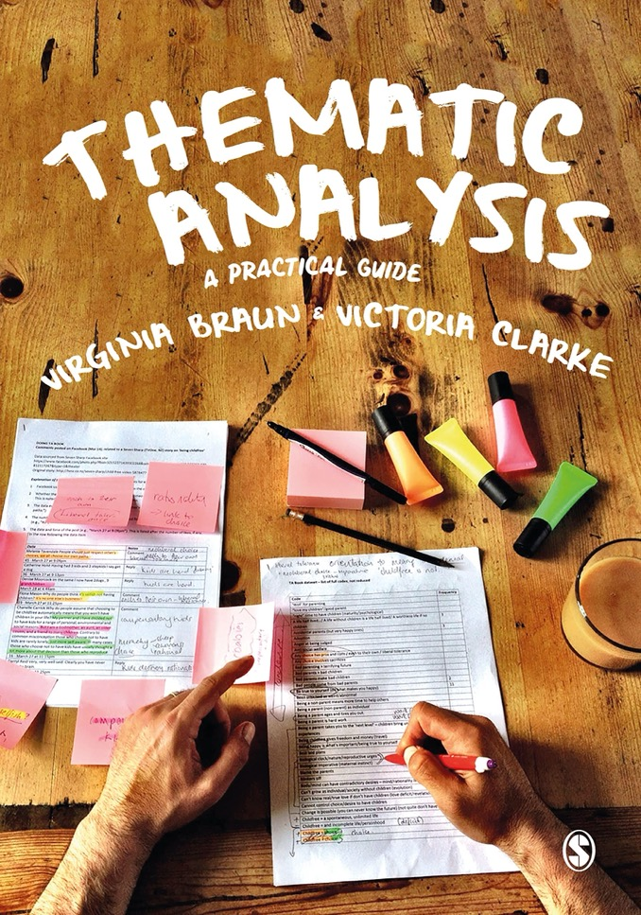
What is Thematic Analysis?
Braun & Clarke classic article from 2008:
“a poorly demarcated, rarely acknowledged, yet widely used qualitative analytic method.”
But also:
“accessible and theoretically flexible approach to analysing qualitative data.”
I describe it as:
“a systematic way to create narrative meaning from a text corpus”
Notes:
reflexive thematic analysis
Where TA sits in the qualitative research landscape
How it’s different to quantitative text analysis
———
⏱ 11:02 · 2 min
Set up the 'why TA is fuzzy but useful' framing. Tighter than before — one good line on each quote, then move.

Slide 4
What is Thematic Analysis?
1. GET FAMILIAR WITH THE DATA
Listen to recordings; read and re-read transcripts
No algorithm/machine learning: manual work is the point!
6 phases
Reflexive
6. PRODUCE THE REPORT
Select extracts, relate back to question, write scholarly report
2. GENERATE CODES
Code data in a systematic way
5. DEFINE AND NAME THEMES
Refine themes, elucidate overall story
3. SEARCH FOR THEMES
Collate codes into potential themes, gather relevant data
4. REVIEW THEMES
Check themes against codes; create the ‘thematic map’
Adapted from Braun, V., & Clarke, V. (2006). Using Thematic Analysis in Psychology. Qualitative Research in Psychology, 3(2), 77–101. https://doi.org/10.1191/1478088706qp063oa
Notes:
⏱ 11:04 · 3 min
Introduce the six phases. You'll CALL BACK to this on slide 15 — say so. Don't dwell; the phases land properly when you do them live.

Slide 5
This is not a TA workshop!
I am not an expert!
TA can adapt to lots of theoretical approaches, lots of methodological variations
I have no opinion on any of that! I’m just sharing a working method.
Two aims for today:
Help you with your TA project, and;
Show you what Obsidian is capable of
Notes:
⏱ 11:07 · 1 min
State the two aims plainly, then move on. Lowers the stakes.

Slide 6

Why Obsidian?
What Obsidian is:
plain-text
Local
linked notes
not a data analysis program
Key features relevant to TA:
bidirectional links,
front matter/properties,
templates,
keyboard shortcuts
plugins
Notes:
⏱ 11:08 · 2 min
Why Obsidian — TA-relevant features only. Resist the tangent.

Slide 7
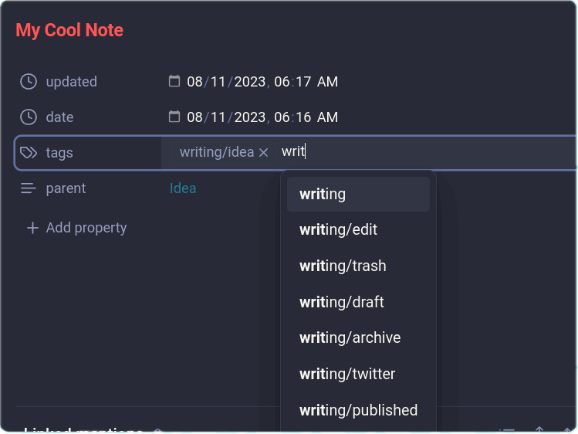
Note properties
Essential to the TA process
Attributes you can give each file
Also called ‘front matter’
Different data types (date, number, tags, etc)
Written in YAML
Allows Obsidian to behave like a database
Image from Obsidian.Rocks, ‘An Introduction to Obsidian Properties’: https://obsidian.rocks/an-introduction-to-obsidian-properties/
Notes:
⏱ 11:10 · 2 min
Properties/front matter — underpins the demos. Keep it to what they'll actually see used.

Slide 8
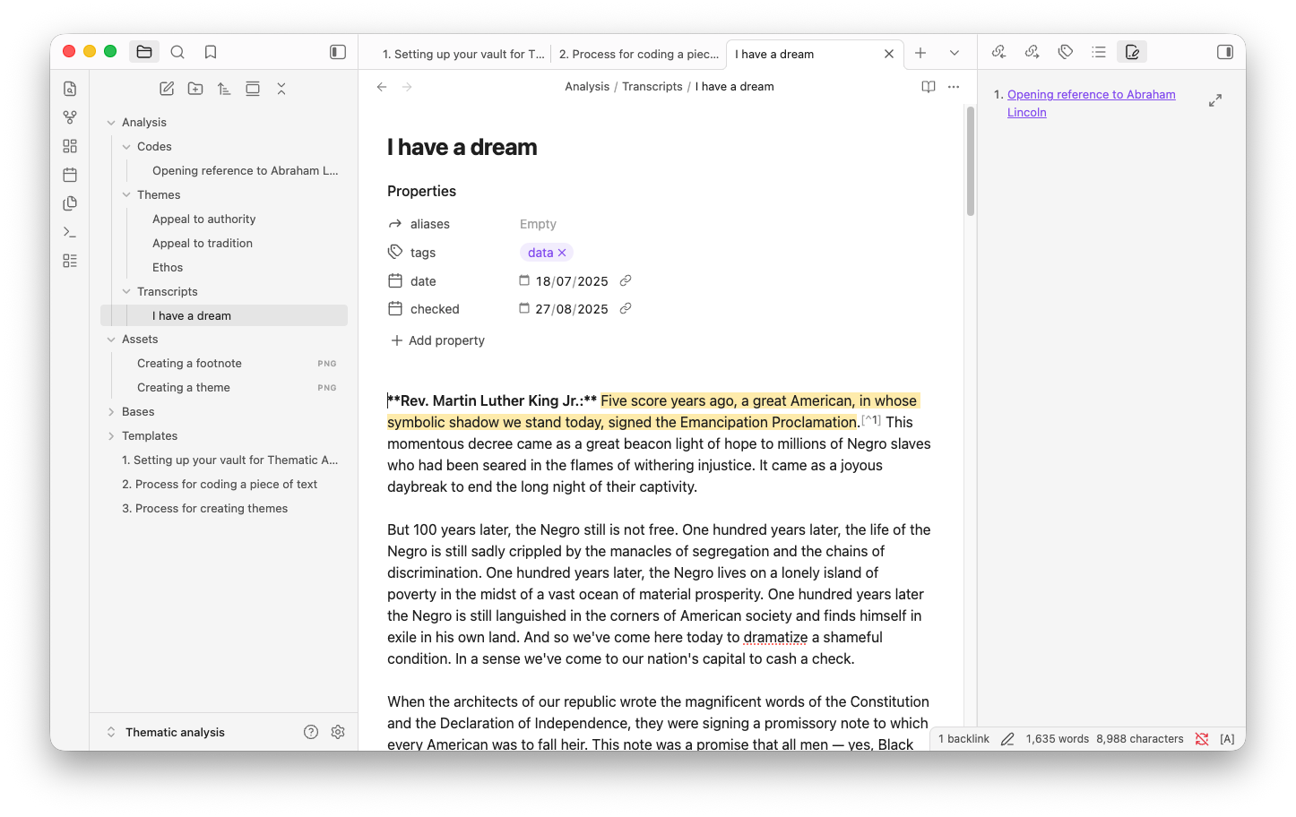
Demo – the finished product
Notes:
Open the completed example vault (default Obsidian appearance — no custom themes or plugins visible)
Walk through: transcript note → code note → theme note
Show how clicking a code surfaces the theme it belongs to, and vice versa
Optional: briefly show what the final write-up/paper stage might look like
———
⏱ 11:12 · 4 min
DEMO 1. Compressible. If you're behind, tighten a demo — never the practice slots.

Slide 9
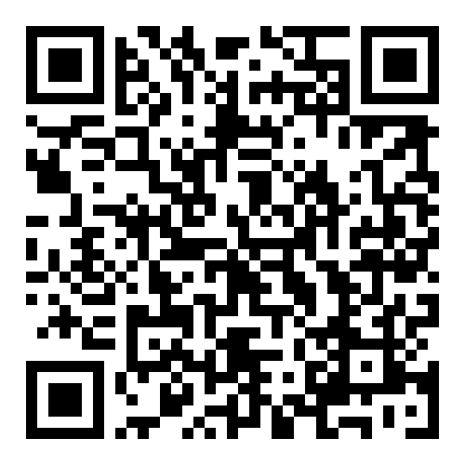
Hands-on – getting set up – ~5 minutes
Get the sample vault: https://ybanens.github.io/talks/resbaz-obsidian
Instructions here: https://ybanens.github.io/talks/resbaz-obsidian/setup
Check for:
Templates in place
Auto note mover plugin in place and set up
Hotkeys set up
How-to notes
Notes:
Open the completed example vault (default Obsidian appearance — no custom themes or plugins visible)
Walk through: transcript note → code note → theme note
Show how clicking a code surfaces the theme it belongs to, and vice versa
Optional: briefly show what the final write-up/paper stage might look like
———
⏱ 11:16 · 5 min
BIGGEST TIME RISK — and there is NO end buffer today. This 5 min only works if people pre-installed Obsidian and the vault. Get that line into the ResBaz pre-event email. Don't advance until most are set up; if it overruns, claw it back from Demo 2 (slide 10) and the themes hands-on (slide 13).

Slide 10
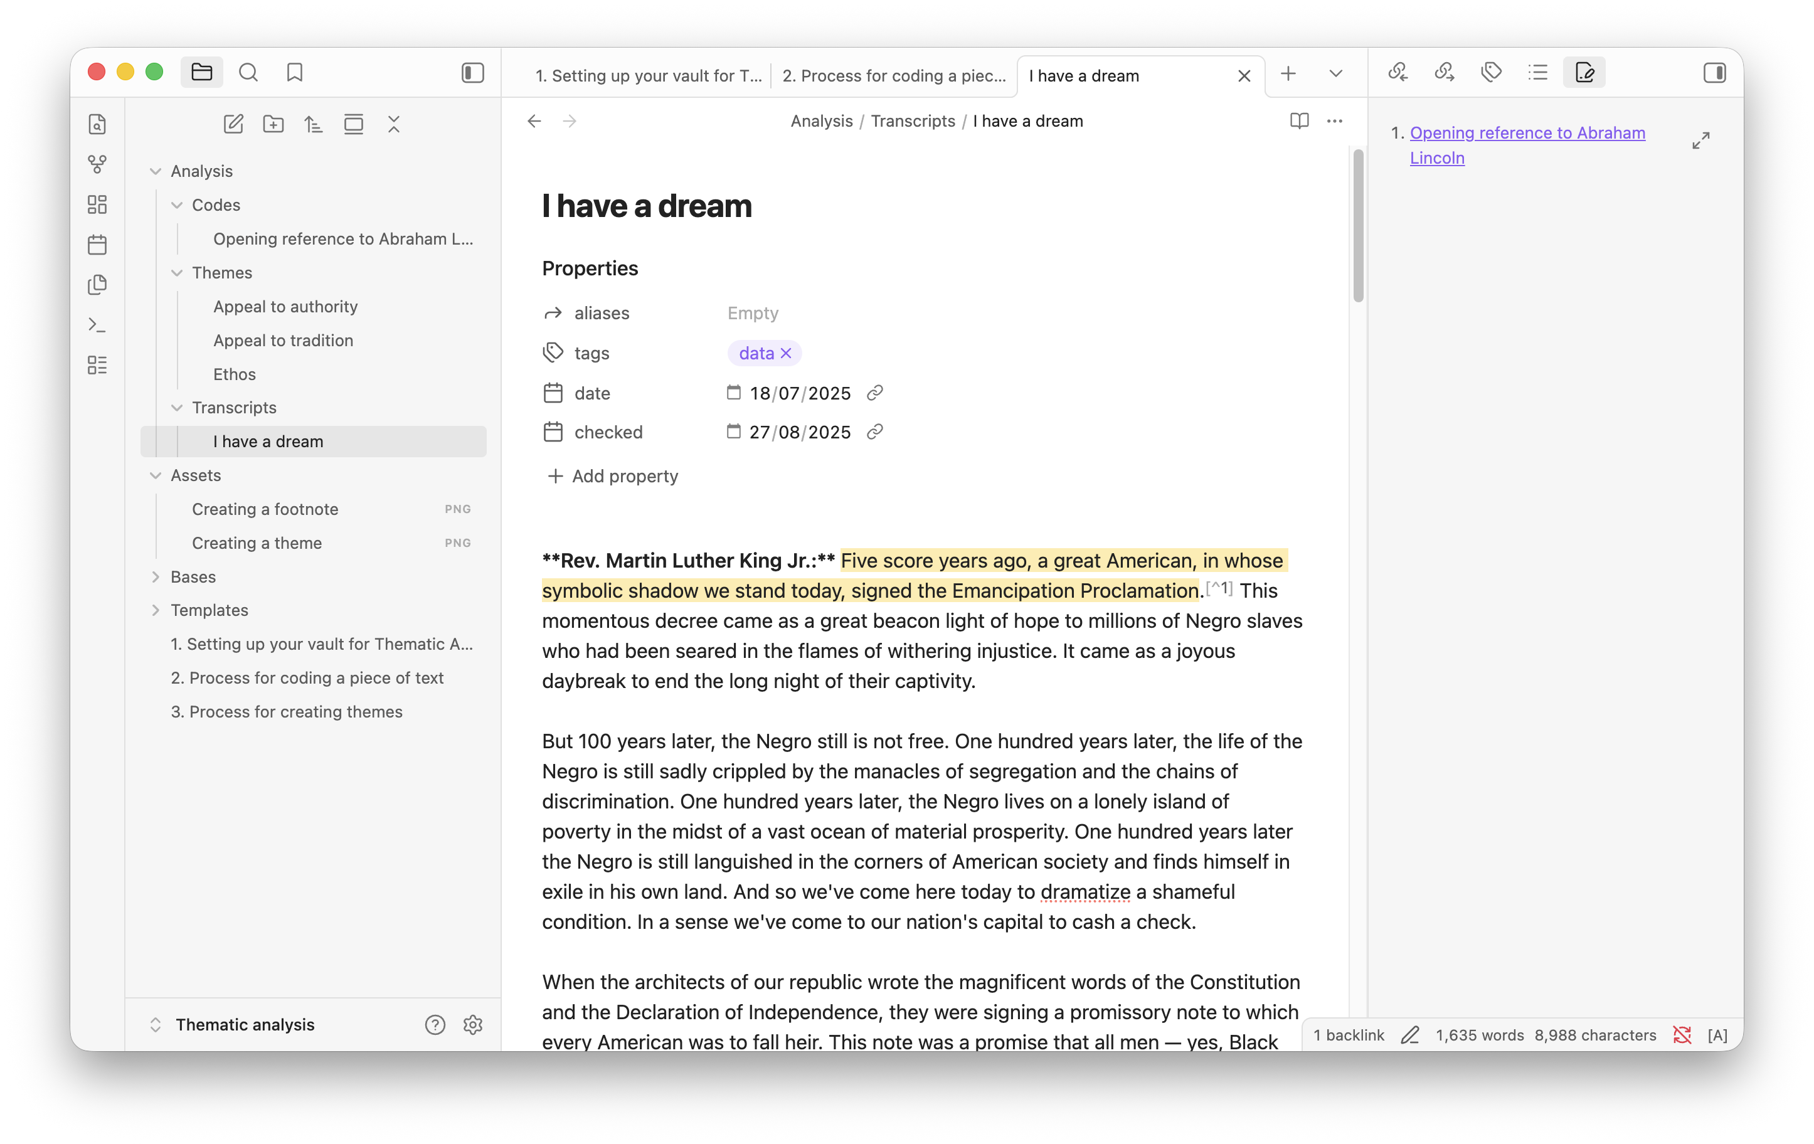
Demo – main coding workflow
Open the example transcript
Highlight a snippet (copy to clipboard)
Add footnote
Create new code (type ”[[“ To start)
Apply template
Fill in properties (paste from clipboard)
Notes:
⏱ 11:21 · 4 min
DEMO 2. First place to compress if setup ran long.

Slide 11

Hands-on – main coding workflow – ~15 minutes
Instructions at: https://ybanens.github.io/talks/resbaz-obsidian/code and in your vault
Open the MLK passage and try coding it yourself
Create several codes to practice the process
You can assign more than one code to a snippet
Yuri will walk round to assist
Notes:
⏱ 11:25 · 15 min
THE HEART OF THE WORKSHOP — protect this. If behind, claw time back from the demos (8/10/12) and the themes hands-on (13), never from here. Walk the room.

Slide 12
Demo – adding themes
Identify a theme
Look through your codes & identify a theme
Add theme to a code’s properties (type ”[[“ To start)
Create the theme note
Click through to create the new theme note
Apply the Theme template
Note how theme note automatically surfaces all codes pointing to it
Go back and assign remaining codes to the theme (or to multiple themes)
Keyboard shortcuts
Shortcut for inserting a code
Shortcut for inserting a theme
Notes:
⏱ 11:40 · 4 min
DEMO 3. Compressible.

Slide 13
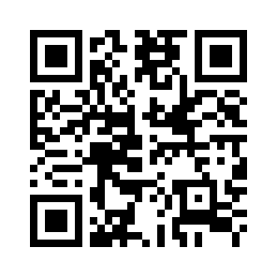
Hands-on – adding themes – ~7 minutes
Instructions at: https://ybanens.github.io/talks/resbaz-obsidian/theme and in your vault
Identify a theme
Gather 3–4 codes; identify a theme
Add theme to a code's front matter
Create the theme note
Click through to create the new theme note
Apply the Theme template (use your hotkey!)
Go back and assign remaining codes to the theme
Notes:
⏱ 11:44 · 7 min
Themes hands-on — now the shock absorber for the whole session. If you're behind, shorten it or make it watch-along. Remind them: a code can belong to more than one theme.

Slide 14
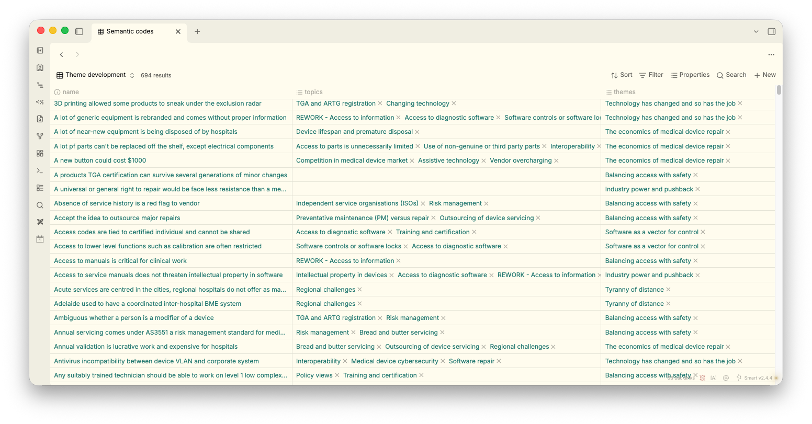
Demo – ‘bases’
Notes:
⏱ 11:51 · 2 min
Topics-vs-themes story — the most memorable bit. Worth telling well even when short.

Slide 15
My experience – topics vs themes
Created way too many ‘themes’ (~60)
Realised they were topics
Grouped into 6-7 main themes
Notes:
⏱ 11:51 · 2 min
Topics-vs-themes story — the most memorable bit. Worth telling well even when short.

Slide 16
Wrap-up – workflow summary
1. GET FAMILIAR WITH THE DATA
Listen to recordings; read and re-read transcripts
2. GENERATE CODES
Code data in a systematic way
3. SEARCH FOR THEMES
Collate codes into potential themes, gather relevant data
4. REVIEW THEMES
Check themes against codes; create the ‘thematic map’
Notes:
⏱ 11:53 · 2 min
CALL BACK to slide 4: map transcript → code → theme → write-up onto the six phases, out loud.

Slide 17

Wrap-up – further reading and contact
Further reading: Braun & Clarke
GitHub link again
Q&A
Stay in touch: y.banens@griffith.edu.au
Notes:
⏱ 11:55 · 3 min
Q&A. If the room was literate and you saved demo time, hand the surplus here.

Slide 18

Enjoy the rest of ResBaz!
Notes:
⏱ 11:58 · 1 min
Close. ~1 min slack to 12:00.

